Slide 1


HVS​
Concept of Charge Management

Slide 2

Contents
Vehicle Charge status management
Charging energy caculation
Remain charge time
Charge preheating

Slide 3
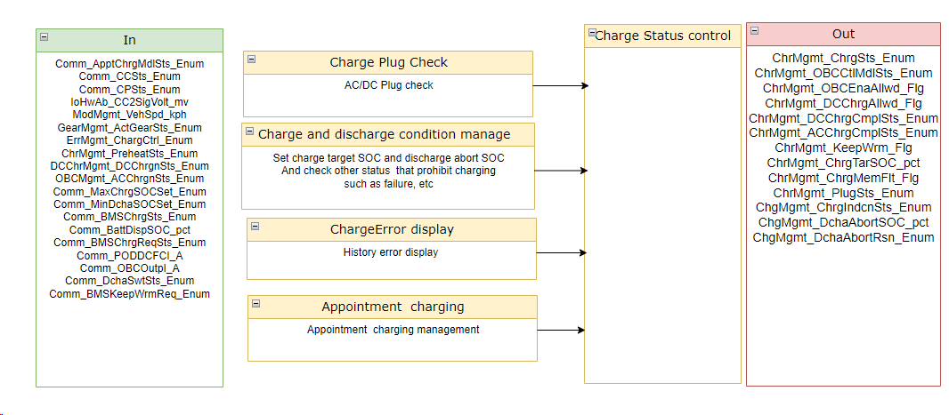
Vehicle charge status management
Electronic lock control and diagnosis

Slide 4
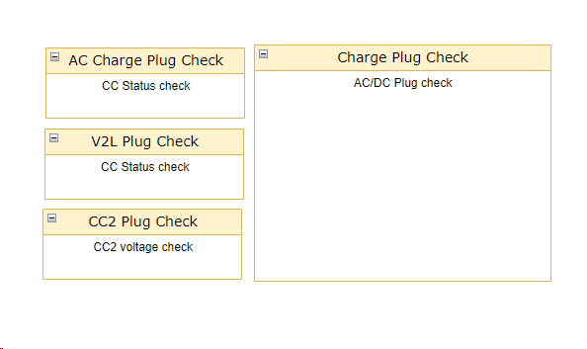
Vehicle charge status management
Electronic lock control and diagnosis
Charge plug check

Slide 5
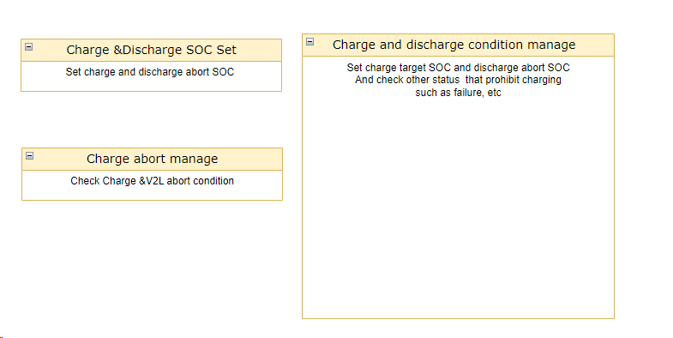
Vehicle charge status management
Electronic lock control and diagnosis
Charge and discharge condition manage

Slide 6
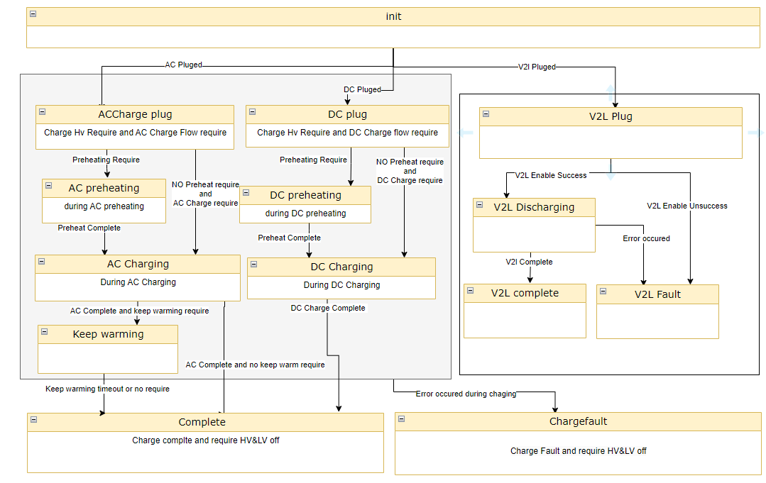
Vehicle charge status management
Electronic lock control and diagnosis
Charge Status control
0x0:Init
0x1: Off Plug
0x2: AC Plug Detected
0x3: DC Plug Detected
0x4: V2L Plug Detected
0x5: AC Charging
0x6: DC Charging
0x7: V2L Discharging
0x8: Charging Completed
0x9: Fault
0xA: AC Preheating
0xB: DC Preheating
0xC:V2Lcompleted
0xD:KeepWarming
0xE:V2L Fault

Slide 7
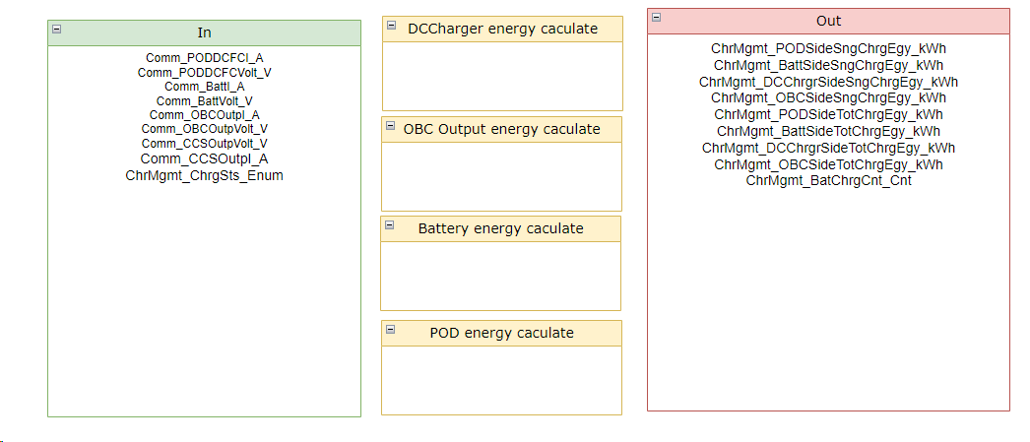
Charging energy caculation
Electronic lock control and diagnosis

Slide 8
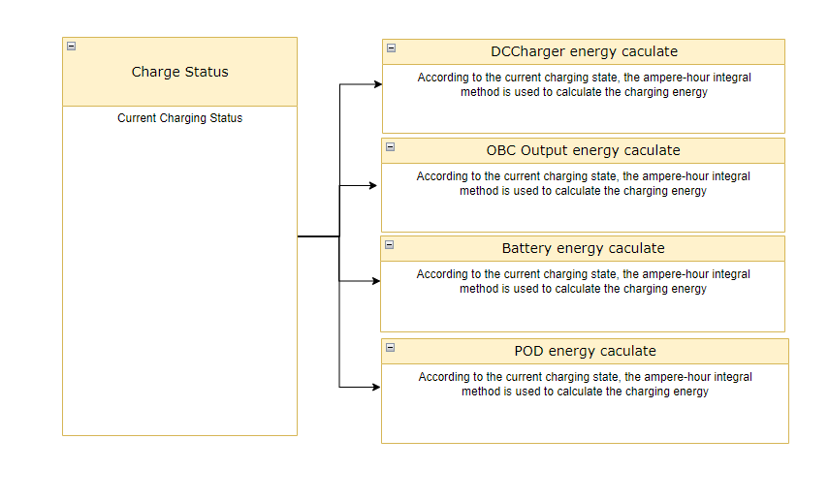
Charging energy caculation
Electronic lock control and diagnosis

Slide 9
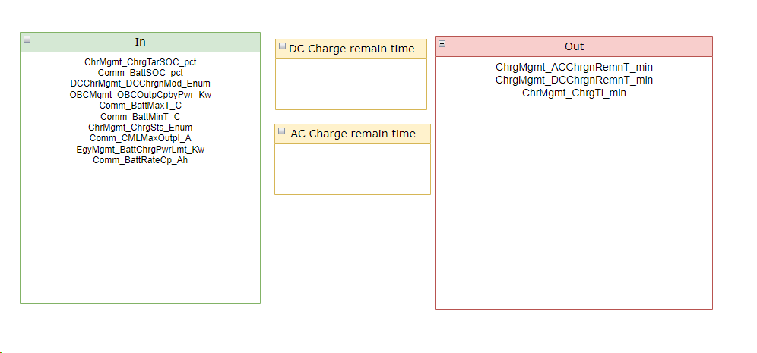
Remain charge time
Electronic lock control and diagnosis

Slide 10
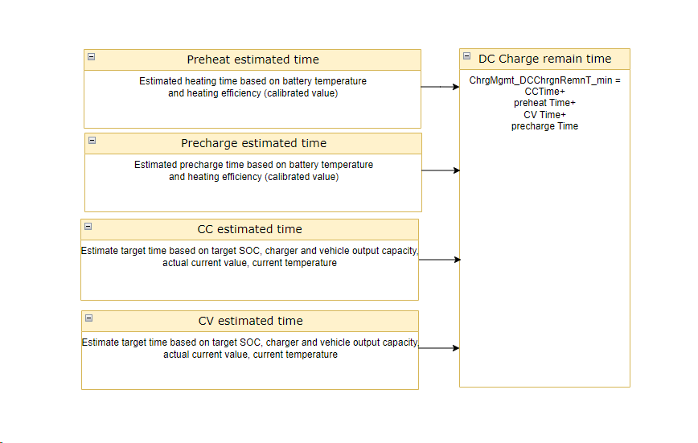
Remain charge time
Electronic lock control and diagnosis
DC Charge remain time

Slide 11
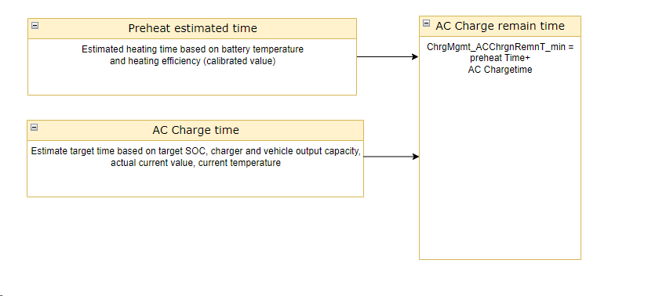
Remain charge time
Electronic lock control and diagnosis
AC Charge remain time

Slide 12
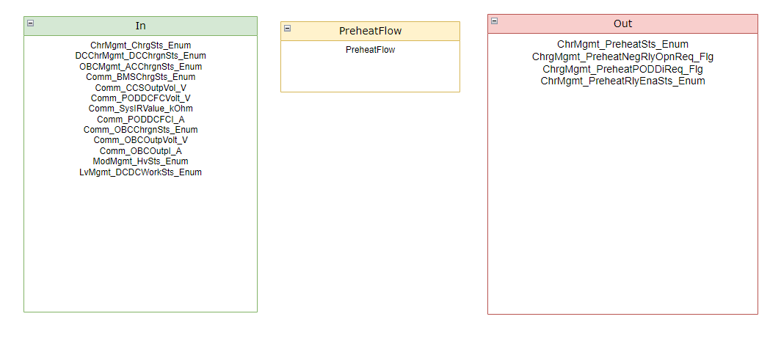
Charge preheating
Electronic lock control and diagnosis

Slide 13
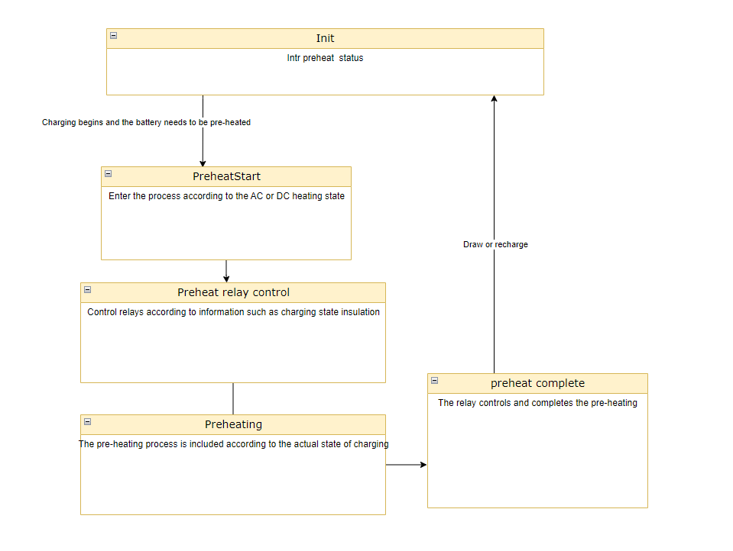
Charge preheating
Electronic lock control and diagnosis

Slide 14
Backup

